Slide 1
Detection and Prevention of Node Overlap : List-Based Approaches for High-Dimensional Environments"
Reg.No | Name of the Student | Branch
BL.SC.P2DSC23014 | K THEJAA | Data Science
Project Advisor Dr. Supriya M
Associate Professor Dept. of Computer Science and Engineering

Slide 2
Table of Contents
INTRODUCTION
MOTIVATION & NEED
PROBLEM STATEMENT
OBJECTIVE & NOVELTY
LITERATURE SURVEY
METHODOLOGY
IMPLEMENTATION
CHALLENGES
RESULTS
CONCLUSION

Slide 3
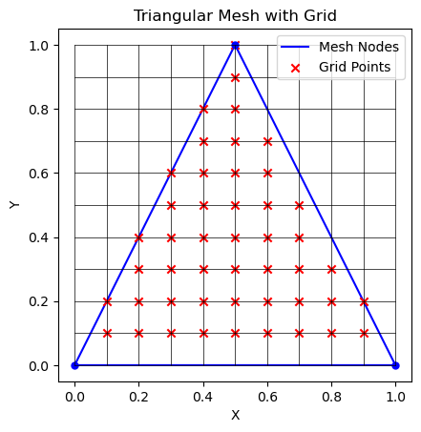
INTRODUCTION
Lists for overlapping nodes: Sequential storage, dynamic connectivity, ease of traversal, adaptive ordering, and memory efficiency.
Efficient kd-tree organization for hierarchical mesh data access.
Trees for overlapping nodes: Hierarchical organization, efficient search, balancing for uniformity, spatial partitioning, and handling complex relationships.
A triangular mesh is a 3D surface representation composed of interconnected triangles

Slide 4
MOTIVATION & NEED
Current node overlap detection algorithms encounter scalability issues, especially in high-dimensional environments.
Elevate node overlap detection in high dimensions through a list-based approach for improved performance.
Respond to the dynamic nature of high-dimensional datasets with a list-based algorithm.
Optimize memory utilization in node overlap detection by replacing traditional tree structures with lists.

Slide 5
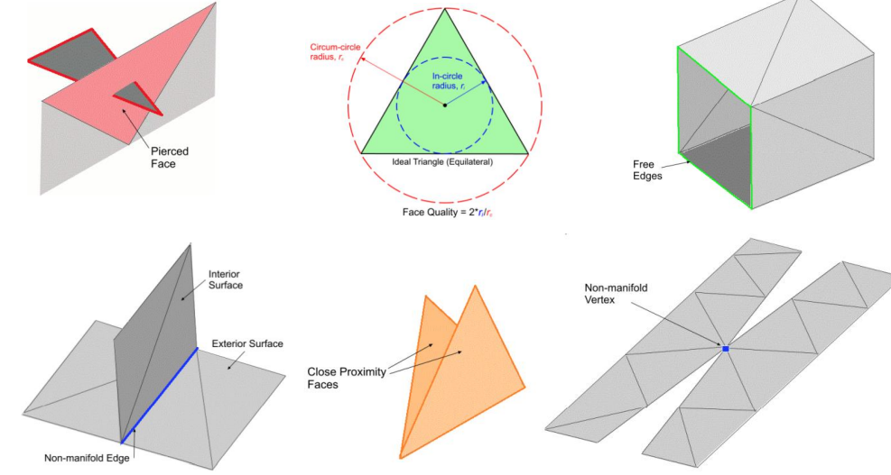
PROBLEM STATEMENT
Existing node overlap detection algorithms encounter difficulties in handling high-dimensional spaces, especially with traditional tree-based structures that show limitations.

Slide 6
OBJECTIVE & NOVELTY
Improve findOverlappingNodes algorithm for quicker and more scalable detection of overlapping nodes in high-dimensional scenarios.
Implement a novel data structure using lists to represent nodes, ensuring that the structure is optimized for efficient traversal and manipulation in high-dimensional spaces.
Explicitly highlight the shift from traditional tree-based structures to a list-based approach for node overlap detection in high-dimensional spaces.

Slide 7
LITERATURE SURVEY
S.NO | AUTHOR NAME | TITLE OF PAPER | METHODOLOGY USED
1 | Magnus Grandin | Data structures and algorithms for high-dimensional structured adaptive mesh refinement | kdTree
2 | Michael Thune | Parallel Structured Adaptive Mesh Refinement | kdTree, SAMR

Slide 8
METHODOLOGY
Literature Review
Iterative Refinement
Advanced Technique Identification
Documentation and Reporting
Selection Criteria
Algorithm Modification
Parallelization Integration
Adaptive Data Structures
Performance Metrics Definition
Simulation and Testing
.
.
.

Slide 9
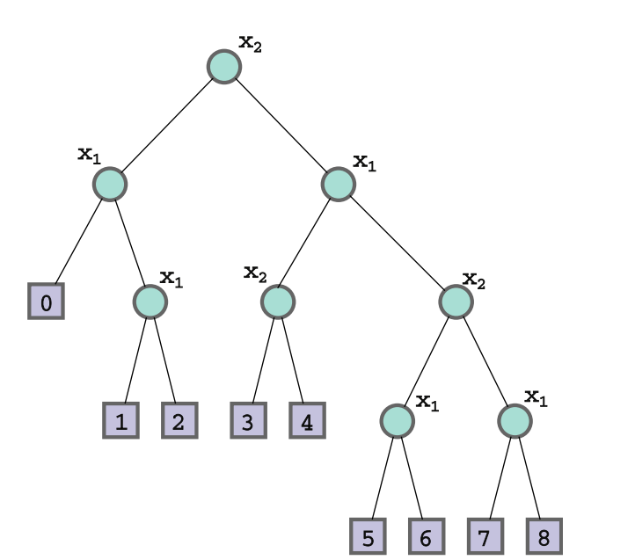
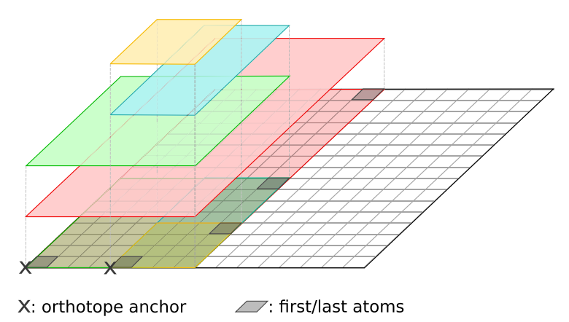
DATA STRUCTURE
LISTS & kdTREE
Each element has a specific position or index within the sequence.
Lists can dynamically grow or shrink in size
A KD-tree is a binary tree where each node represents an axis-aligned hyperrectangle (or region) in k-dimensional space.
KD-trees are efficient for searching and querying multidimensional data.

Slide 10
IMPLEMENTATION
Concept
Knowledge about Lists and its operations for the specific application
Generation of Grid with overlapping nodes
Input is taken from the GMSH / coded in python to generate the triangular mesh.
Data structure implemented is List & search structure is triangular mesh
Approach:
Initially create a 2d grid with overlapping and non-overlapping nodes using List.
Application of Lists to perform the analysis
Coordinates are Extracted and Mesh domain is determined where the overlapping points are there

Slide 11
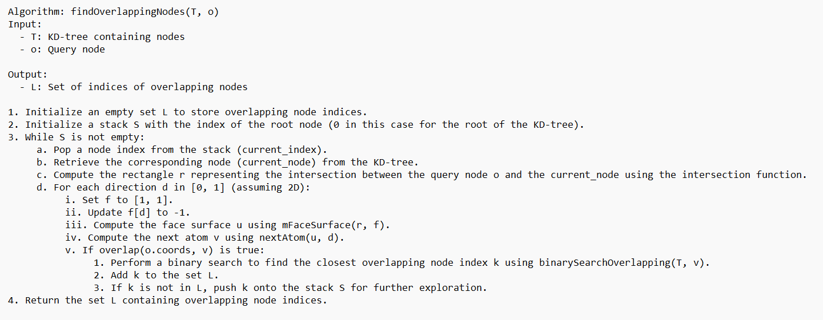
IMPLEMENTATION
Existing Implementation for Creating and Finding

Slide 12
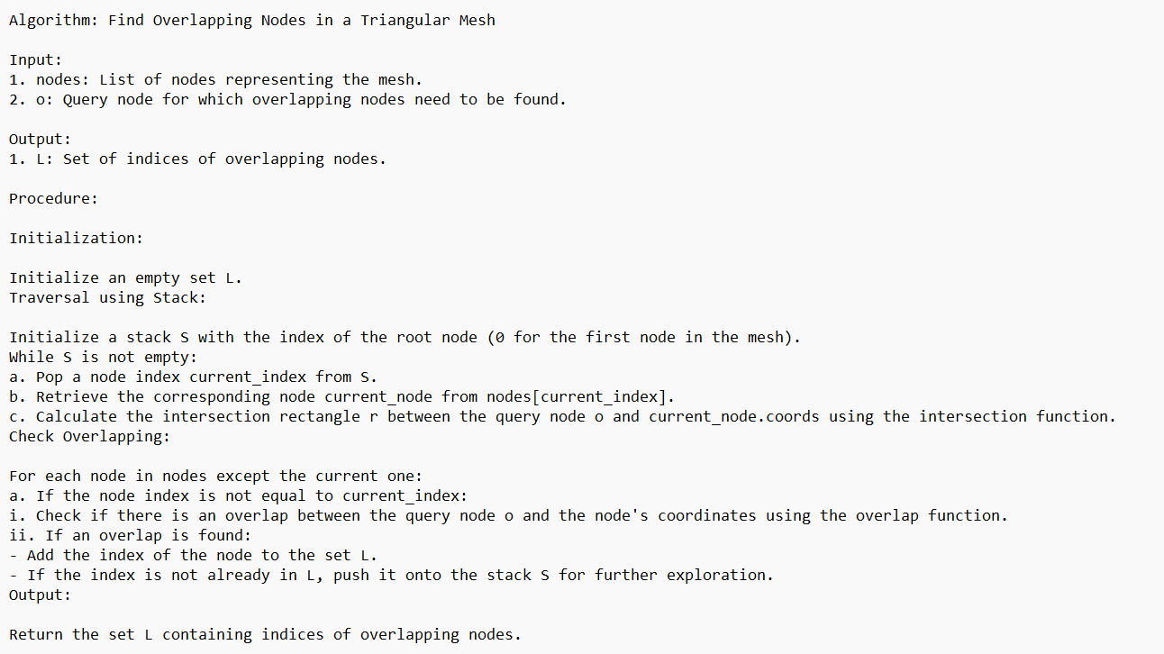
IMPLEMENTATION
Current Implementation for Creating and Finding

Slide 13
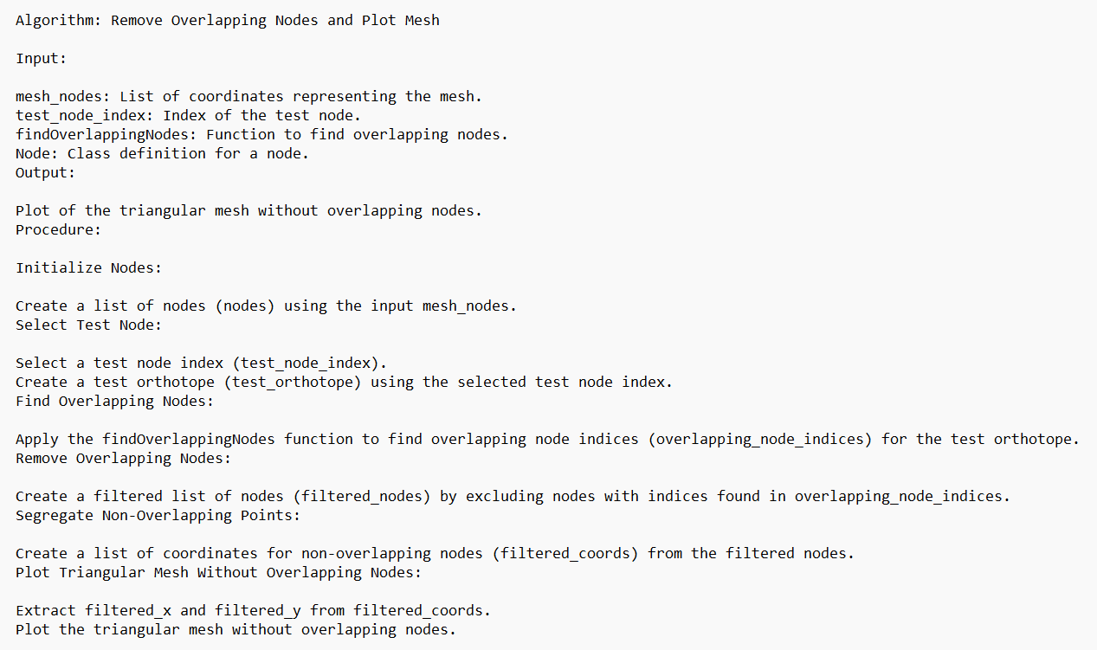
IMPLEMENTATION
Removing the Overlapping nodes

Slide 14
CHALLENGES
Adapting to dynamic changes in dimensionality for robust performance.
Balancing data storage and processing without excessive memory overhead.
Managing increased computational complexity in high-dimensional spaces.

Slide 15
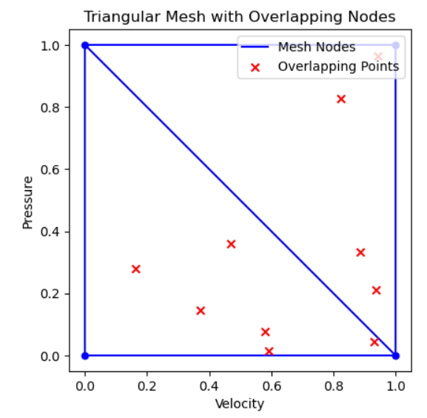
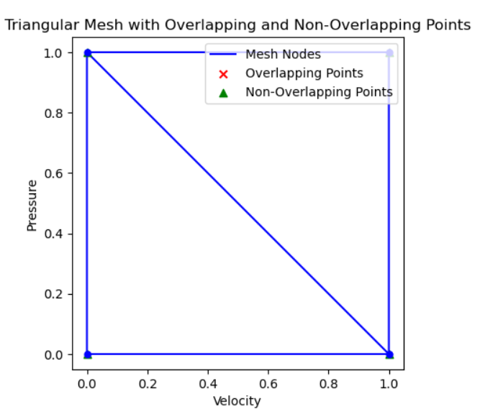
RESULTS
Fig1: Mesh with Overlapping Nodes
Fig2: Mesh with Non- Overlapping Nodes

Slide 16
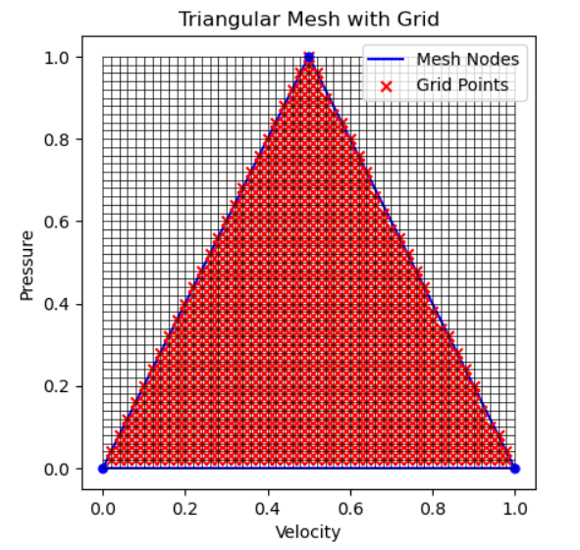
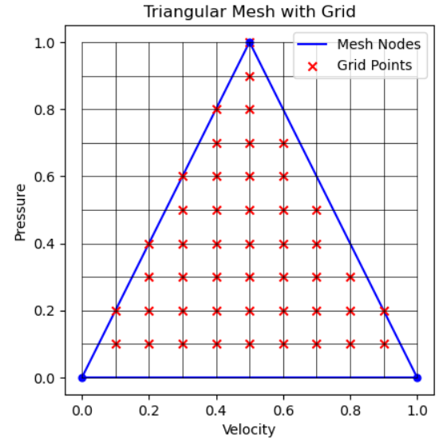
Fig1: Mesh with Overlapping Nodes
Fig2: Mesh with Non- Overlapping Nodes

Slide 17
CONCLUSION
List has achieved the target
The proposed improvements aim to achieve quicker and more scalable detection of overlapping nodes.
Research contributes to optimizing node overlap detection methods
Future scope: Applying for Dynamic Meshes and Meshless Methods

Slide 18
THANK YOU

